Slide 1
Concepts of Boolean Algebra

Slide 2
Lecture 16 Simplification Using Boolean Algebra
Lecture delivered by:
Deepak V.

Slide 3
Objectives
At the end of this lecture, student will be able to:
Acquire the knowledge Boolean Analysis of Logic Circuits
Construct a Logic Circuit

Slide 4
Topics
Simplification Using Boolean Algebra
Draw a Logic Circuit

Slide 5
Simplification Using Boolean Algebra
A simplified Boolean expression uses the fewest gates possible to implement a given expression
Example
Using Boolean algebra techniques, simplify this expression:
AB + A(B + C) + B(B + C)

Slide 6
Simplification Using Boolean Algebra
Solution
Step 1: Apply the distributive law to the second and third terms in the expression, as follows:
AB + AB + AC + BB + BC
Step 2: Apply rule 7 (BB = B) to the fourth term.
AB + AB + AC + B + BC
Step 3: Apply rule 5 (AB + AB = AB) to the first two terms.
AB + AC + B + BC
Step 4: Apply rule 10 (B + BC = B) to the last two terms.
AB + AC + B

Slide 7
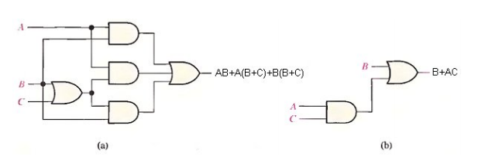
Simplification Using Boolean Algebra
Step 5: Apply rule 10 (AB + B = B) to the first and third terms.
B+AC
At this point the expression is simplified as much as possible.
Figure: Gate circuits for example above.

Slide 8
Simplification Using Boolean Algebra

Slide 9
Simplification Using Boolean Algebra

Slide 10
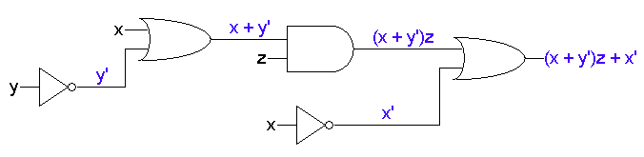
Simplification Using Boolean Algebra
Example
(x + y’)z + x’

Slide 11

Simplification Using Boolean Algebra
The expression and circuit on the previous page are actually equivalent to the simplified ones below:
x’ + z

Slide 12
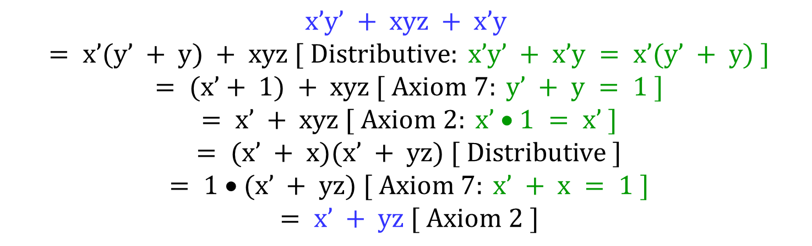
Simplification Using Boolean Algebra
$$x’y’ + xyz + x’y$$
$$= x’(y’ + y) + xyz [ Distributive: x’y’ + x’y = x’(y’ + y) ]$$
$$= (x’+ 1) + xyz [ Axiom 7: y’ + y = 1 ]$$
$$= x’ + xyz [ Axiom 2: x’ • 1 = x’ ]$$
$$= (x’ + x)(x’ + yz) [ Distributive ]$$
$$= 1 • (x’ + yz) [ Axiom 7: x’ + x = 1 ]$$
$$= x’ + yz [ Axiom 2 ]$$

Slide 13
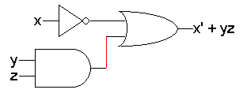
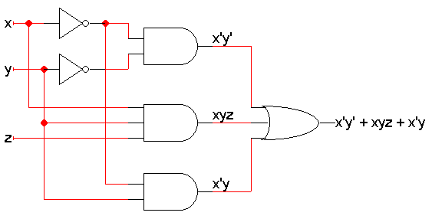
Simpler expressions yield simpler hardware
The resulting from the original and simplified expressions on the previous page

Slide 14
Summary
A simplified Boolean expression uses the fewest gates possible to implement a given expression
The logic circuit can be minimised by using simplification methods

